Slide 1

TRAFFIC LIGHTS Project
Name: احمد أسامة إبراهيم مصطفى النجار
Group: 1

Slide 2
Introduction
The aim of this project is to create a traffic lights system that can operate either automatically of manually using the PIC16F877A Microcontroller

Slide 3
Components
Resistors
Capacitors
Crystal
Button
Four 7448 Decoders
Four 2N2222 transistors
PIC16F877A Microcontroller
Four common-cathode 7 segment display
Switch
Traffic light LEDs

Slide 4
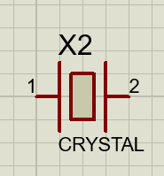
Crystal
Usually, crystal oscillators are preferred in microcontrollers due to advantages such as (accuracy, compactness, low cost, low power consumption, and high-frequency generation). A crystal oscillator is good at providing stable output for a long duration and is popular for its stability and durability.

Slide 5
Microcontroller
Microcontrollers are designed to be low-cost and low-power, making them ideal for use in embedded systems. They are capable of performing a wide range of tasks, from simple control functions to complex data processing and analysis.

Slide 6
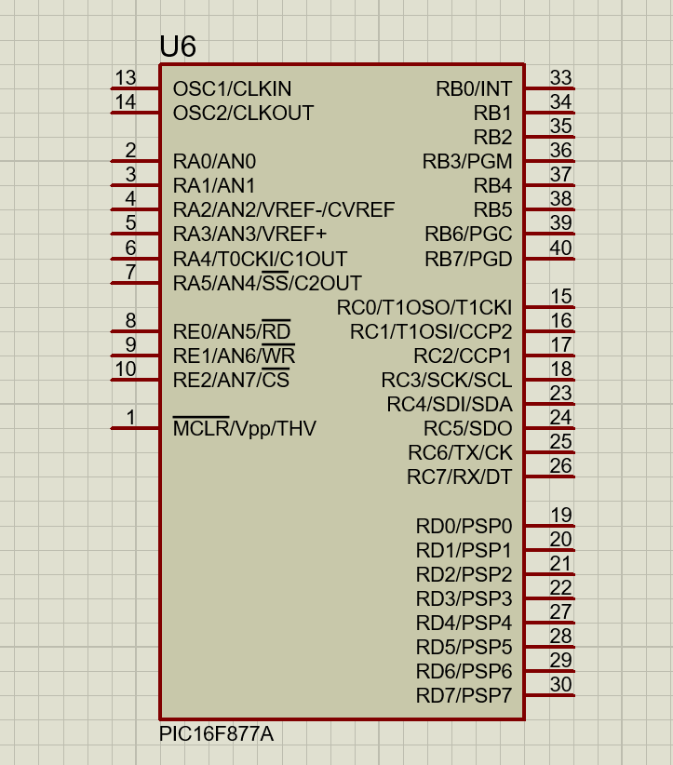
PIC16F877A
The PIC16F877A is used for the project because of its special features which are:
Flash Memory: 14.3 Kbytes (8192 words)
Data SRAM: 368 bytes.
Data EEPROM: 256 bytes.
Self-reprogrammable under software control.
In-Circuit Serial Programming via two pins (5V)
Watchdog Timer with on-chip RC oscillator.
Programmable code protection.
Power-saving Sleep mode.

Slide 7
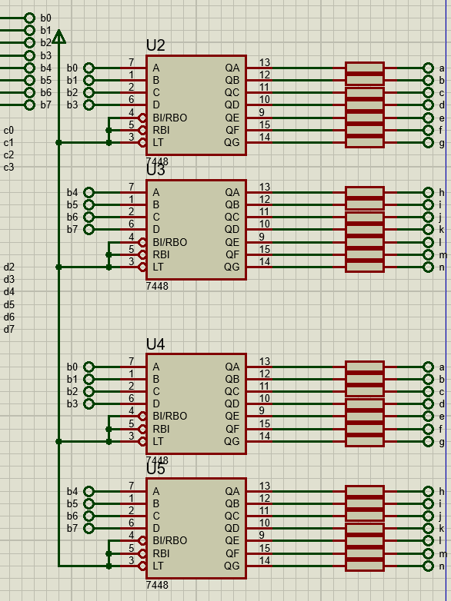
7448 Decoder
Four 7448 Decoders are used to get the output from the microcontroller.
B pins from B0 to B3 take four bits of the Ones and displays it on the right 7-segment.
B pins from B4 to B7 take four bits of the tens and displays it on the right 7-segment.

Slide 8
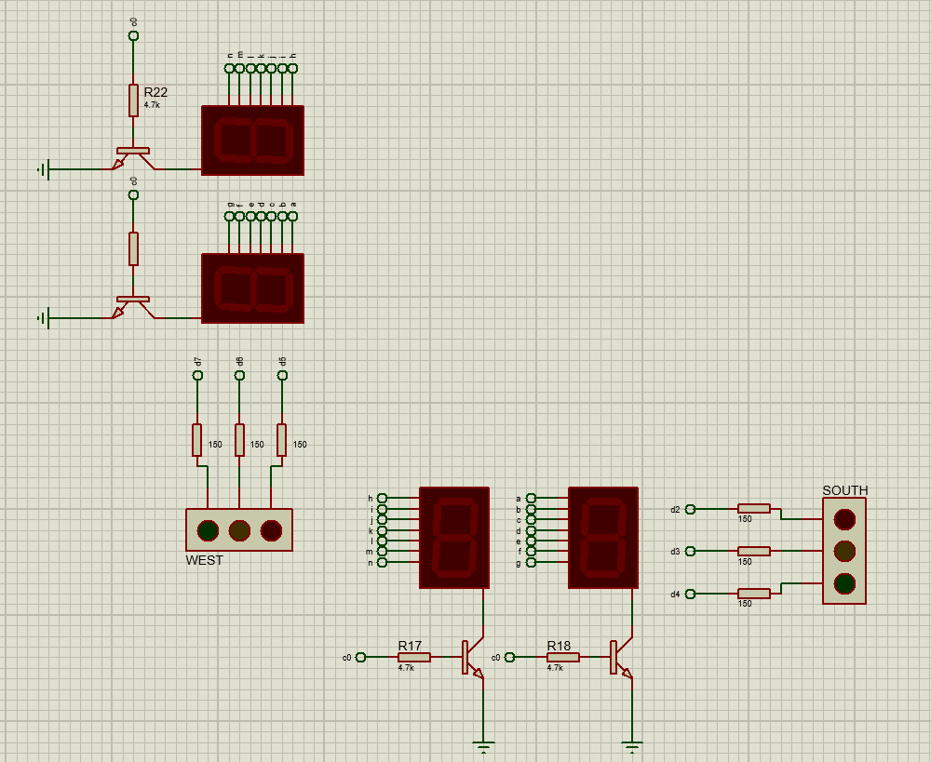
Common-Cathode 7-segment display
Four 7-segment displays are used to show the countdown for traffic lights.
They are connected with 2N2222 transistors to either enable or disable the 7-segments.
Once the timer reaches a certain number the traffic LEDs connected with pins from the microcontroller start to change colors.

Slide 9
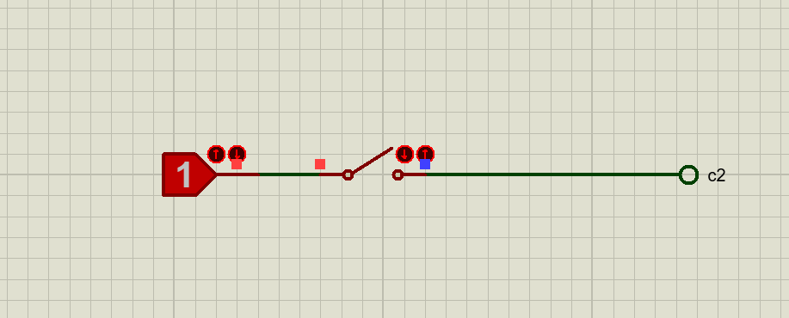
Switch
The switch is used to switch between the manual and automatic operation modes.
When the switch is open it indicates the automatic operation.
When it’s closed it indicates the manual operation.

Slide 10
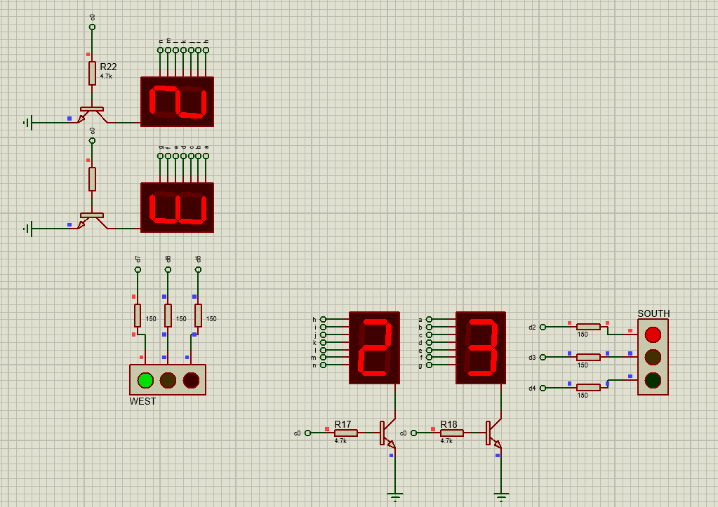
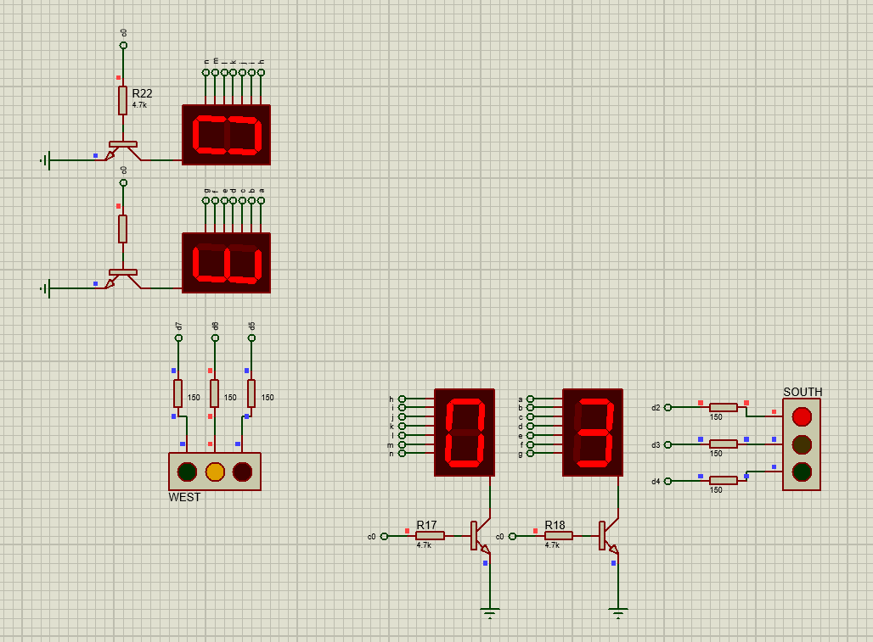
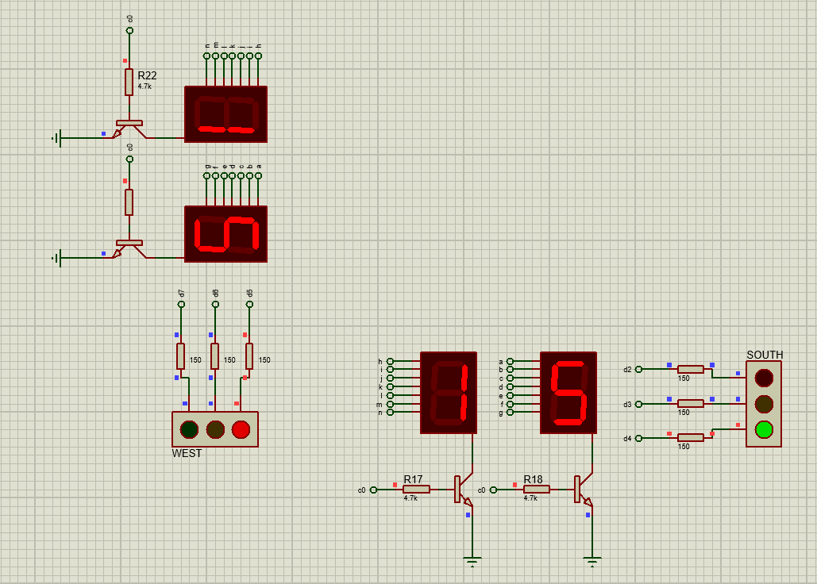
Automatic operation
The 7-segment begins the countdown from the 23 second mark with the south street having Red light and west street green light. When the countdown is at 3 seconds the west light becomes yellow till zero seconds then the light switches becoming green in the south side and red in the west. The timer starts again but at 15 seconds till it reaches 3 seconds then the lights start switch again in the south from green to yellow and at zero from yellow to red and the west side becomes green again.

Slide 11
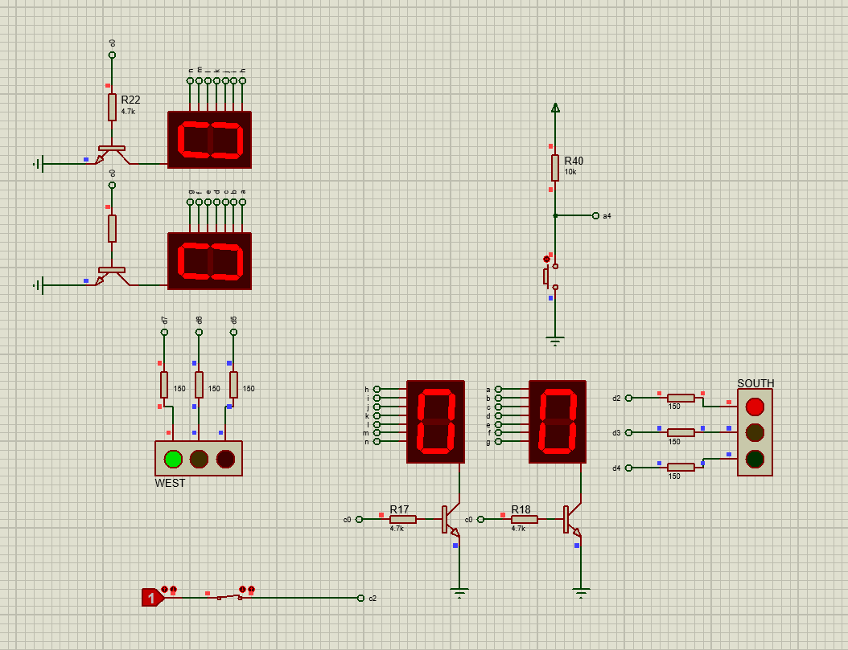
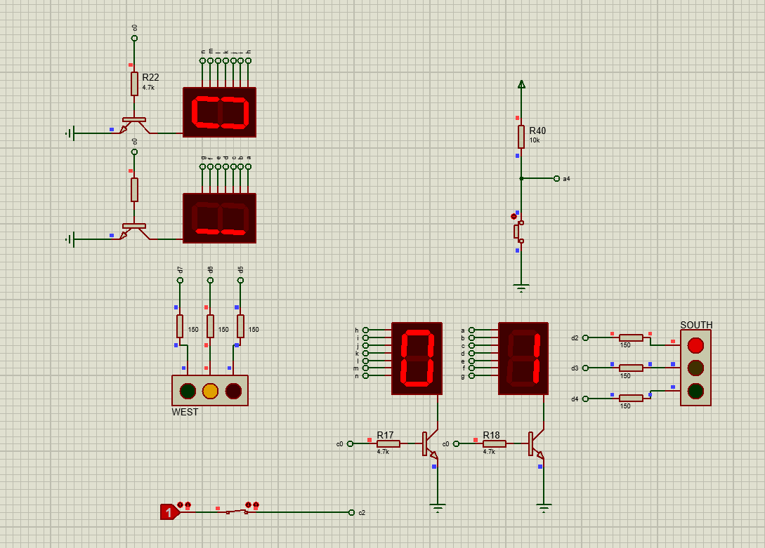
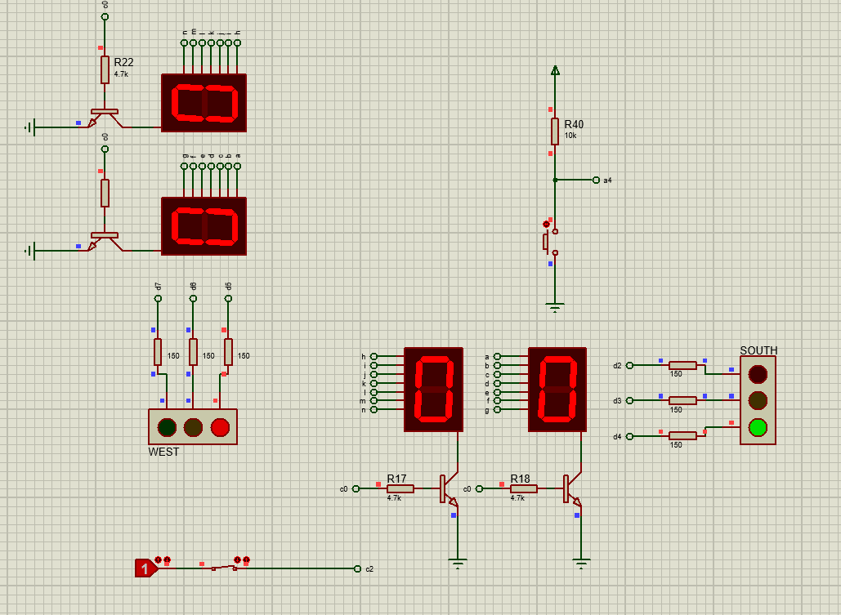
Manual operation
in this mode the switching between lights happens when the button is pressed the 7-segments start to countdown from 3 switching the green to yellow in the west side till it hits zero then the light becomes red and in the south green. When the button is pressed again the south light becomes yellow and then red when the timer hits zero which in turn makes the west side green again.

